Slide 1
Exception Handling in Java & Stream Classes in Java

Slide 2
Exception Handling in Java
Exceptions are run-time conditions that can cause the program to terminate abnormally.
Then what is an error?
Errors are mistakes in code that do not conform with the language requirements and cannot be handled.
Thus, when encountered, will definitely terminate the program execution
But, Exceptions can be handled…..

Slide 3
A java exception is simply an object that describes the exceptional condition occurring in piece of code.
When an exceptional condition arises, an object representing that exception is created and thrown.
If we want the program should continue execution of the remaining code, then catch the exception object and perform corrective actions

Slide 4
Who generates the exception?
Java run-time
Manually generated in our code
Exceptions thrown by java relate to violation of fundamental rules of Java.
Manual exception objects are thrown, when you want to define your own exceptional cases.

Slide 5
Exception handling mechanism
Try block
Statements that cause exception
Exception object creator
Throws exception object
Catch block
Statements that handle the exception
Exception object handler

Slide 6
Java exception handling uses 5 keywords
try:
try block is used to enclose the code block that can generate the exception
Whenever an exception occurs, it will be thrown
2. catch:
catch handler block is used to catch the exception and successfully handle it

Slide 7
3. throw:
Used to manually throw an exception object.
System generated runtime errors (exceptions) are internally thrown by Java Runtime system
4. throws:
The throws clause is used to declare that a method can throw a specified exception and the caller should be aware of it
5. finally:
Used to enclose a piece of code that must mandatorily be executed after the try block completion.
It is placed after the last catch block

Slide 8
Types of exceptions
Checked(Compile time) exceptions:
Explicitly handled in the code itself, with try catch block.
These exceptions are extended from the java.lang.Exception class
Unchecked(Run time)exceptions:
JVM handles these exceptions
These exceptions are extended from the java.lang.RuntimeException class
The difference is only in the way of handling exceptions

Slide 9
Uncaught Exception
class ExceptionDemo
{
public static void main(String a[])
{
int a=42, d=0;
int r=a/d;
System.out.println(“a: ”+a);
}
}
System.out.println(“Continue execution after catch…..");
Here the default handler(Java) terminates the program displays a string describing the exception & stacktrace of exception.
java.lang.ArithmeticException: / by zero at ExceptionDemo.main(ExceptionDemo.java:7)

Slide 10
Explicitly handling exception
class ExceptionDemo
{
public static void main(String ar[])
{
int d, a;
try
{
d=0;
a=42/d;
System.out.println("a: "+a);
}
catch(ArithmeticException e)
{
System.out.println("Division by zero…");
}
System.out.println(“Continue execution after catch…..");
// System.out.println("a: "+a);
}
}

Slide 11
Multiple catch clauses
class ExceptionDemo
{
public static void main(String ar[])
{
int d, a;
try
{
d= ar.length;;
a= 42/d;
int c[]= {1,8,9,10};
c[48]= 99;
}
catch(ArithmeticException e)
{
System.out.println("Division by zero…");
}
catch(ArrayIndexOutOfBoundException e)
{
System.out.println("ArrayIndexOutOfBoundException..…");
}
System.out.println(“Continue execution after catch…..");
}
}

Slide 12
Throwing are own exceptions
To throw our own exception use keyword “throw”
throw new Throwable_Subclass
Eg.
throw new ArithmeticException();
throw new NumberFormatException();
throw new MyException();

Slide 13
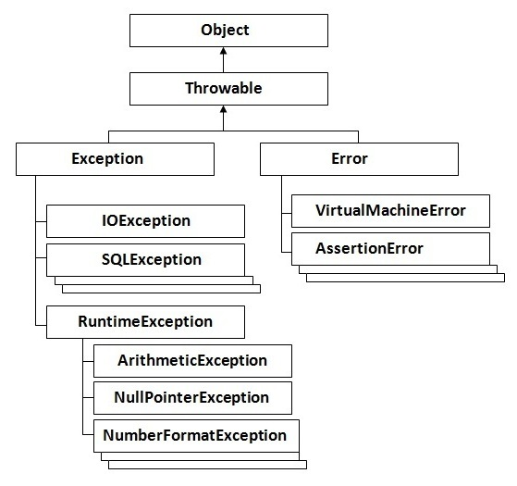
Hierarchy

Slide 14
Our own Exception class
package ExceptionHandling;
public class InsufficientFundsException extends Exception {
InsufficientFundsException(double bal)
{
System.err.println("Amount is exceeds the available Balance("+bal+")!!");
}
}

Slide 15
package ExceptionHandling;
public class AccountCheck
{
double balance;
void deposit(double amt)
{
balance+=amt;
}
void withdraw(double amt) throws InsufficientFundsException
{
if(amt<=balance)
balance-=amt;
else
throw new InsufficientFundsException(balance);
}
}

Slide 16
package ExceptionHandling;
import java.util.Scanner;
public class BankDemo {
public static void main(String a[])
{
int ch;
AccountCheck c=new AccountCheck();
try
{
do
{
System.out.println("1. Balance Enquiry\n2. Deposit\n3. Withdraw");
ch=new Scanner(System.in).nextInt();
switch(ch)
{
case 1: System.out.println("Your account balance is: "+c.balance);
break;
case 2:System.out.println("Enter the amount to deposit");
double amt=new Scanner(System.in).nextDouble();
c.deposit(amt);
break;

Slide 17
case 3: System.out.println("Enter the amount to withdraw");
amt=new Scanner(System.in).nextDouble();
try {
c.withdraw(amt);
}
catch (InsufficientFundsException ex)
{
System.out.println("Caught....");
}
break;
}
}while(ch<=3);
}
catch(Exception e)
{
e.printStackTrace();
}
}
}

Slide 18
Write a java code to accept two integers(x,y) from user. Compute z=x/y and handle the exception if z is smaller than 0.01

Slide 19
“finally” keyword
“finally” block can be used to handle exceptions those are not caught by any of the previous catch statements
It can be used to handle any exception generated within a try block
When a finally block is added it is guaranteed to execute, regardless of whether or not an exception is thrown
After an exception is generated, the remaining code of the try block gets skipped.
Hence, place the important code (like closing a file or releasing other resources) in the finally block

Slide 20
public class ExcepDemo{
public static void main(String a[]){
try{
int a=5,b=0,result;
System.out.println(“ try starts..”);
result=a/b;
System.out.println(“After exception in try”);
}
catch(ArithmeticException ae)
{System.out.println(“caught in main..”);}
finally{
System.out.println(“Some important code…”};}
System.out.println(“After Exception handling..”);
}
}

Slide 21
Built-in Exceptions
ArithmeticException: caused by math errors like divide by zero
ArrayIndexOutOfBoundException: caused by bad array indexes
ArrayStoreException: caused by an attempt to store wrong type of data in an array
FileNotFoundException: caused by an attempt to access non-existent file
IOException: caused by general I/O failure, like unable to read from a file or the console

Slide 22
OutOfMemoryException: caused when there is not enough memory to allocate a new object
NullPointerException: caused by referencing a null object
StringIndexOutOfBoundsException: caused by an attempt to access a non-existent character position in a string
IllegalArgumentException: Invalid argument used to call a method
ClassNotFoundException: Class definition not found
IllegalAccessException: Attempt to access unreachable class

Slide 23
Nested try statements
It’s a try-catch block placed inside an outer try-catch block
If the inner try block does not have a catch block for a particular exception, then the outer catch (or immediately next catch) will be evaluated for the generated exception

Slide 24
public class ExcDemo{
public static void main(String a[])
{
try{
int a=8/1;
try{
int arr[]={1,2};
arr[10]=5;
}
catch(NullPointerException ne)
{
System.out.println(“Caught in inner catch…”);
}
}
catch(Exception e)
{
System.out.println(“Caught in outer catch…”+e);
}
System.out.println(“execution continues..”);
}}

Slide 25
Managing I/O
Problem with variables, arrays, etc:
They are volatile(lost with program termination)
Large volume of data cannot be contained in variable and arrays
Then to store the data on secondary storage, we use files
In file processing, input is flow of data into the program and output is vice-versa
Java uses the concept of streams to represent ordered sequence of data
Java Stream are classified in 2 types:
Input Stream
Output Stream

Slide 26
STREAM CLASSES IN JAVA
java.io package contains the stream classes for processing all types of data
These classes are of 2 types:
Byte stream classes
Character stream classes

Slide 27
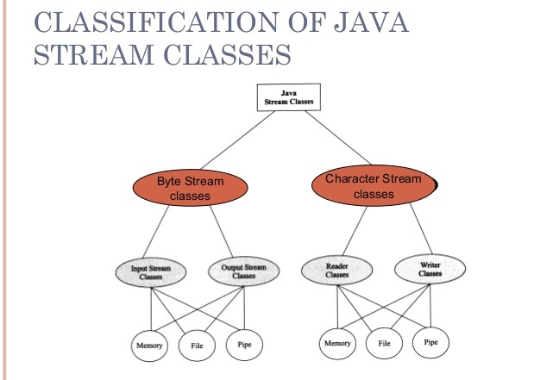

Slide 28
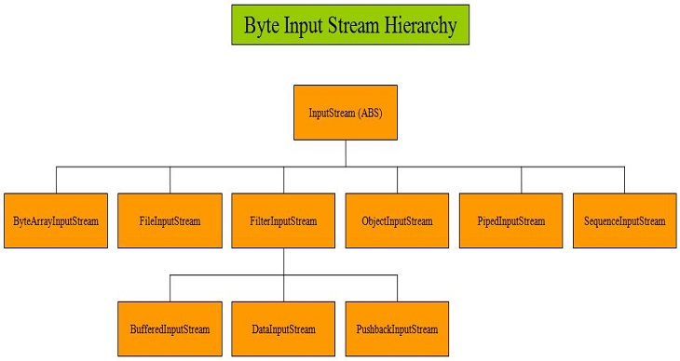

Slide 29
InputStream: Abstract byte stream superclass which describes this type of input stream.
ByteArrayInputStream: Input byte stream that reads bytes from an internal byte array.
FileInputStream: Input byte stream that reads bytes from a file.
BufferedInputStream: Input byte stream that reads bytes into an internal buffer before use.
DataInputStream: Input stream to reads Java’s primitive data types.
ObjectInputStream: Input stream for objects

Slide 30
Using Input Stream classes and methods
FileInputStream class:
File file = new File("C:/robots.txt");
FileInputStream fis = new FileInputStream(file);
byte content;
while((content=fis.read())!=-1)
System.out.print((char) content);
fis.close();

Slide 31
DataInputStream class:
DataInputStream d= new DataInputStream( new FileInputStream("binary.dat"));
int aByte = d.read();
int anInt = d.readInt();
float aFloat = d.readFloat();
double aDouble = d.readDouble();
d.close();

Slide 32
BufferedInputStream class:
File file = new File("C:/FileIO/ReadFile.txt");
FileInputStream fin = new FileInputStream(file);
BufferedInputStream
bin = new BufferedInputStream(fin);
bin.read();
fin.close();

Slide 33
ObjectInputStream class:
FileInputStream fis = new FileInputStream("t.tmp");
ObjectInputStream ois = new ObjectInputStream(fis);
int i = ois.readInt();
String today = (String) ois.readObject();
Date date = (Date) ois.readObject();
MyClass myobj = (MyClass) ois.readObject();
fis.close();

Slide 34
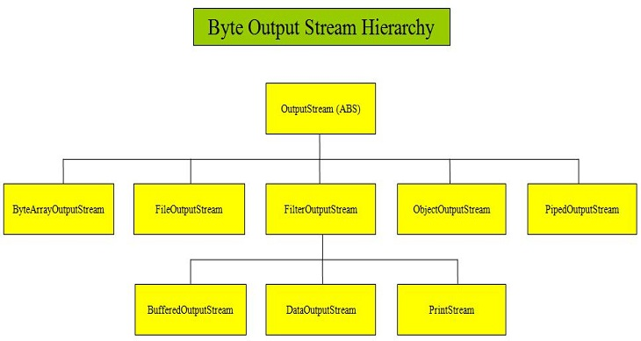

Slide 35
OutputStream
ByteArrayOutputStream
FileOutputStream
BufferedOutputStream
DataOutputStream
ObjectOutputStream

Slide 36
5. ObjectOutputStream class:
FileOutputStream fos = new FileOutputStream("t.tmp");
ObjectOutputStream oos =new ObjectOutputStream(fos);
oos.writeInt(12345);
oos.writeObject("Today");
oos.writeObject(new Date());
oos.writeObject(new MyClass());
oos.close();

Slide 37
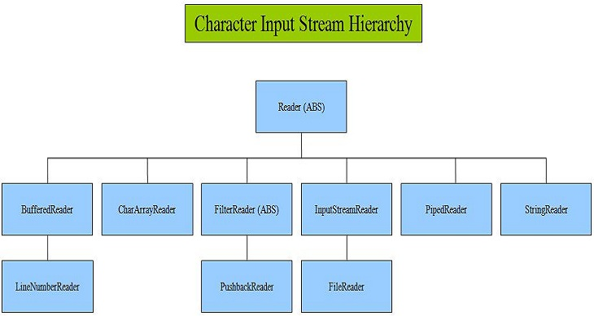

Slide 38
Reader: Abstract character stream superclass which describes this type of input stream.
BufferedReader: Buffered input character stream.
CharArrayReader: Input stream to read from a character array
InputStreamReader: Input Stream that acts as a bridge for decoding byte streams into character streams.
FileReader: Input Stream for reading characters from a file.
StringReader: Input stream for reading characters from a string.

Slide 39
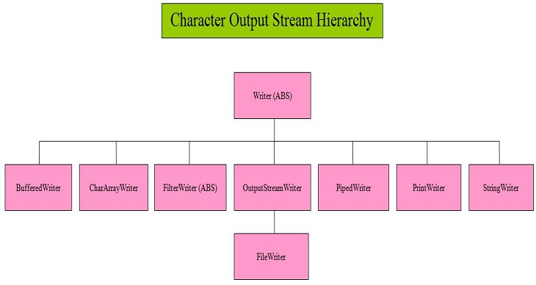

Slide 40
Writer (ABS)
FileWriter
BufferedWriter
CharArrayWriter
OutputStreamWriter
StringWriter

Slide 41
Reading Console Input
System.in is used to read input from the console
Most Java programmers use character stream to read the console input since, the input is provided as discrete characters
To obtain a input character stream, the already available object System.in is used
System.in is wrapped into InputStreamReader & this newly created object is again wrapped into BufferedReader object

Slide 42
InputStreamReader class converts the byte oriented System.in into a character oriented object
The BufferedReader class converts the character stream object into buffered version of stream object
BufferedReader br=new BufferedReader( new InputStreamReader (System.in )) ;

Slide 43
BufferedReader uses read() method to read a single character from the input stream
It returns -1 when end of the stream is encountered.
This read() method might throw an IOException

Slide 44
import java.io.*;
public class IODemo{
public static void main(String a[]){
char a;
BufferedReader br=new BufferedReader( new InputStreamReader (System.in )) ;
System.out.println(“Enter a character:”);
try{
do{
a=(char)br.read();
System.out.println(a);
}while(a!=‘e’)
}catch(IOException e)
{
System.out.println(“Caught…”);
}
}
}
Use readLine() to read entire string from the input stream

Slide 45
Writing Console Output
Writing to the console is mainly done via the print() and println() methods
We may use the write() method to write on console.
void write (int byteVal)
the byte value passed as argument is an integer representing the lower order bytes of the value to be written

Slide 46
import java.io.*;
public class IODemo{
public static void main(String a[]){
int byteVal=97;
System.out.write(byteVal);
}
}
OUTPUT:
a

Slide 47
PrintWriter Class
PrintWriter is a character based class for writing on the console
PrintWriter supports the character stream that is able to write any international character
Constructor to create the object of PrintWriter class:
PrintWriter (OutputStream outstreamobj, Boolean flushEnable)
First argument is the OutputStream available with us i.e. System.out

Slide 48
Second argument is to enable or disable the flush (whether to flush the output from buffer after every println() ).
PrintWriter class has both the method: print() and println()

Slide 49
import java.io.*;
public class IODemo{
public static void main(String a[]){
PrintWriter pw= new PrintWriter (System.out, true)
pw.println(“using println() ”);
pw.print(“with PrintWriter class”);
pw.print(“object…”);
pw.println(“”);
}
}

